Slide 1
Counselor and Advisor Training: Module 1
College Scorecard Website Training
Notes:
Welcome participants to the training and introduce yourself.

Slide 2
Session Norms
Participate and engage
Be fully present
Be generous with the knowledge you share with the group
Respect others’ opinions
Share airtime equitably
Notes:
Share session norms and ask for participants to indicate that they agree with these norms (i.e., thumbs up/thumbs down). Extend the opportunity to add to or edit the norms to fit the group.

Slide 3
College Access Advisors Modules
Module 1: Introduction to College Scorecard
Module 2: Navigating and Utilizing College Scorecard
Module 3: Practical Application of College Scorecard

Slide 4
Learning Objective
Explain how students make postsecondary enrollment decisions
Understand how students make postsecondary enrollment decisions based on individual preferences and how the College Scorecard can help inform students to identify institutions and programs that may be a good fit for their unique needs.

Slide 5
Group Activator
What are the main obstacles students encounter when seeking information to make informed college decisions?
In your opinion, what are the top three obstacles?

Slide 6
The Role of Advisors and School Counselors

Slide 7
Equity in U.S. Higher Education
There is a wide context of inequity in higher education
  Wealth and income disparities
  Race and ethnicity disparities
  Increased percentage of low-income students
54% of college students identified as first-generation
In 2020, among the Most Competitive Institutions, an average of 24 percent of enrolled students received Pell grants, compared to an average of 68 percent receiving Pell Grants at the least competitive institutions.
Sources:
Cahalan, Margaret W., Addison, Marisha, Brunt, Nicole, Patel, Pooja R., Vaughan III, Terry, Genao, Alysia & Perna, Laura W. (2022). Indicators of Higher Education Equity in the United States: 2022 Historical Trend Report. Washington, DC: The Pell Institute for the Study of Opportunity in Higher Education, Council for Opportunity in Education (COE), and Alliance for Higher Education and Democracy of the University of Pennsylvania (PennAHEAD)
RTI International. (2023). First-generation College Students in 2020: Demographic Characteristics and Postsecondary Enrollment. Washington, DC: NASPA. Retrieved from https://firstgen.naspa.org/files/dmfile/15405_NASPA_FactSheet-01.pdf

Slide 8
About the College Scorecard

Slide 9
What is College Scorecard?
The U.S. Department of Education’s College Scorecard is a free online tool that helps students, families, educators, counselors, and other college access professionals make data-informed decisions when choosing a college or university to attend.

Slide 10
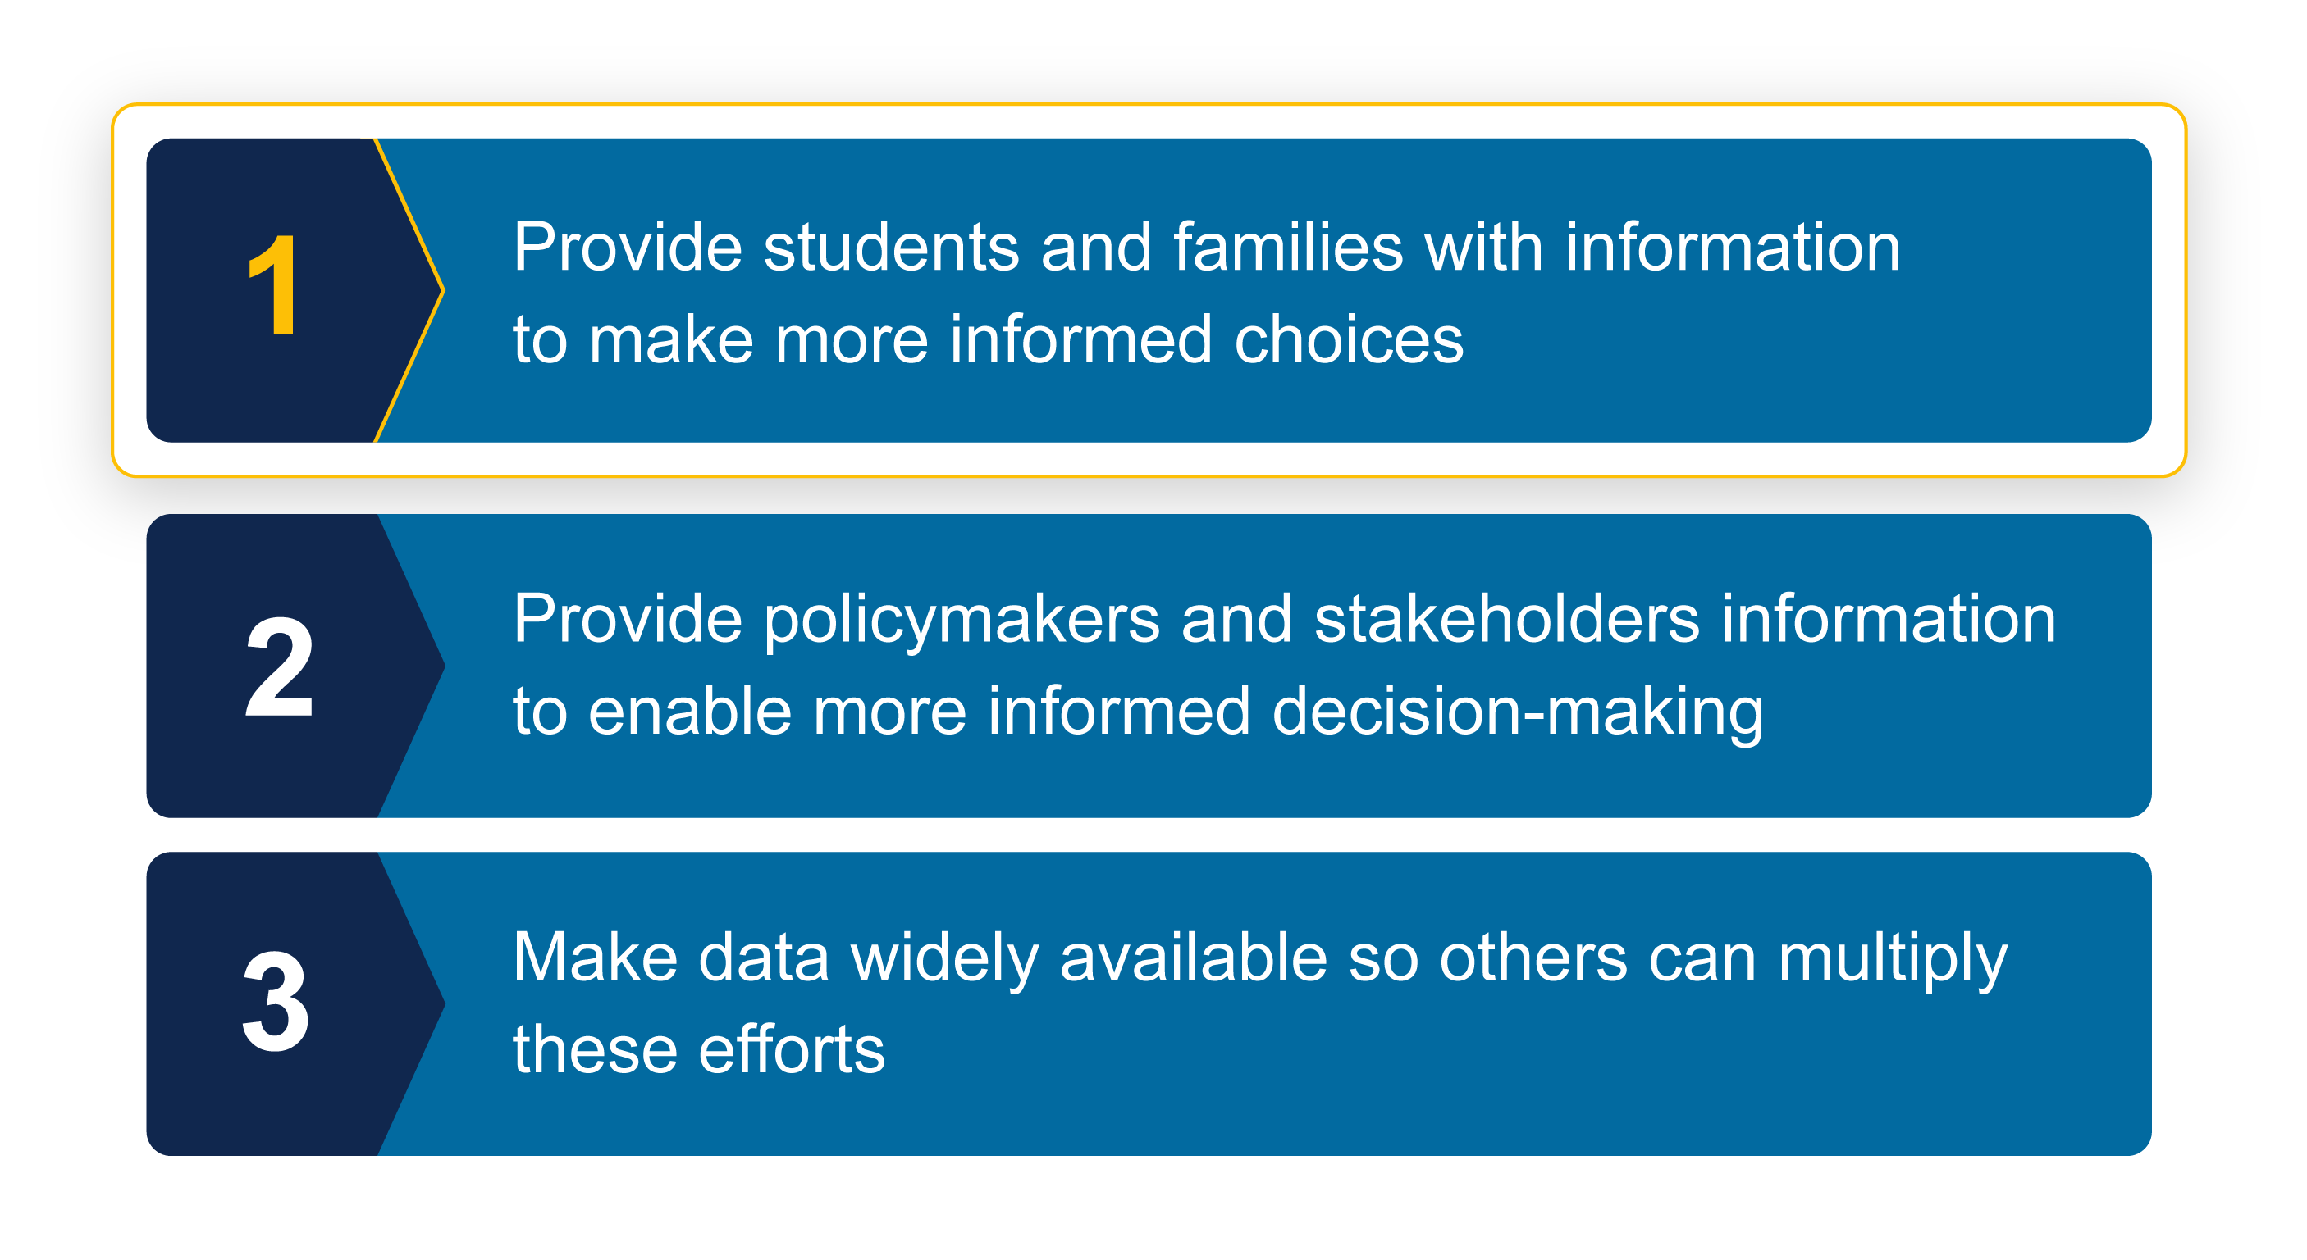
College Scorecard Goals

Slide 11
Benefits of College Scorecard

Slide 12

Benefits of Using College Scorecard
Inform decision-making
Plan your finances
Compare schools easily
Customize your search
Locate accurate data from a reliable source

Slide 13
Primary Benefits for Students
Focus on high-priority data elements, providing a filtered and refined view
Reliable data from accurate sources, ensuring trustworthiness in decision-making
1
2

Slide 14

Importance of Key Metrics
Metric | What It Measures | Why It Matters
Graduation Rate | Share of students who graduated within 8 years of entering the school for the first time | Indicates the likelihood of student success and institutional effectiveness.
Average Annual Cost (in-state only) | School’s cost of attendance minus any grants and scholarships students receive | Indicates a student’s average net price, offering a more accurate estimate of what a student might pay after receiving financial aid.
Median Earnings | The median annual earning of individuals that received federal student aid and began college at the institution 10 years ago, regardless of their completion status | Indicates which institutions produce graduates with higher earnings and which ones may not provide strong returns on investment.
College Navigator is a secondary resource that allows users to access graduation rates by race, total cost of attendance, and out-of-state costs.
Website: https://nces.ed.gov/collegenavigator/

Slide 15
Benefits of College Scorecard
Review the Benefits of Using College Scorecard Handout (Handout 1)
What strikes you as a priority category for students? For parents?
What challenges or misconceptions about these data categories do you anticipate? How would you respond?

Slide 16
Reflection

Slide 17
Reflection
Share your responses to the prompts below.
Summarize the benefit of using College Scorecard in your own words.
How would you describe the benefit of using College Scorecard to students? To parents/families?
Questions about the College Scorecard? Contact scorecarddata@rti.org.

Slide 18

Questions & Answers

