Slide 1
Counselor and Advisor Training: Module 2
College Scorecard Website Training
Notes:
Welcome participants to the training and introduce yourself.

Slide 2
Session Norms
Participate and engage
Be fully present
Be generous with the knowledge you share with the group
Respect others’ opinions
Share airtime equitably
Notes:
Share session norms and ask for participants to indicate that they agree with these norms (i.e., thumbs up/thumbs down). Extend the opportunity to add to or edit the norms to fit the group.

Slide 3
College Access Advisors Modules
Module 1: Introduction to College Scorecard
Module 2: Navigating and Utilizing College Scorecard
Module 3: Practical Application of College Scorecard

Slide 4
Learning Objectives
Analyze the College Scorecard Data
Identify key data metrics and understand the parameters of College Scorecard data while articulating its unique role for students within the postsecondary education admission process.
Describe the many data sources that contribute to the College Scorecard to provide accurate and comprehensive guidance during the postsecondary education admission process.
Explain the foundational data methodology behind the three core statistics on the school profile page: graduation rate, median earnings, and annual average cost.

Slide 5
Group Activator
How might using data to make college admission decisions support student persistence and/or degree attainment?

Slide 6
Navigating College Scorecard

Slide 7
Key Terms
School/College
A 2- or 4-year degree-awarding educational institution.
Field of Study
Categories of programs of study defined by a both a Classification of Instruction Program (CIP) codes and a credential level.

Slide 8
Parameters of the College Scorecard Data
The data represents students with different experiences– people come into college at different stages.
The data represented on the Scorecard includes data for federal and some non-federal financial aid recipients.
Students have their own priorities and perceptions about what matters most when selecting a school.

Slide 9
Understanding Key College Scorecard Features

Slide 10
Group Discussion
What factors do students believe is important when they are choosing a school or college to attend after high school?
What data are students most interested in exploring when searching for a school or college?

Slide 11




Important Factors for Students
Academic quality/reputation
Having a desired program of study
Job placement after graduation
Cost of attendance
SOURCE: U.S. Department of Education. National Center for Education Statistics, 2019

Slide 12
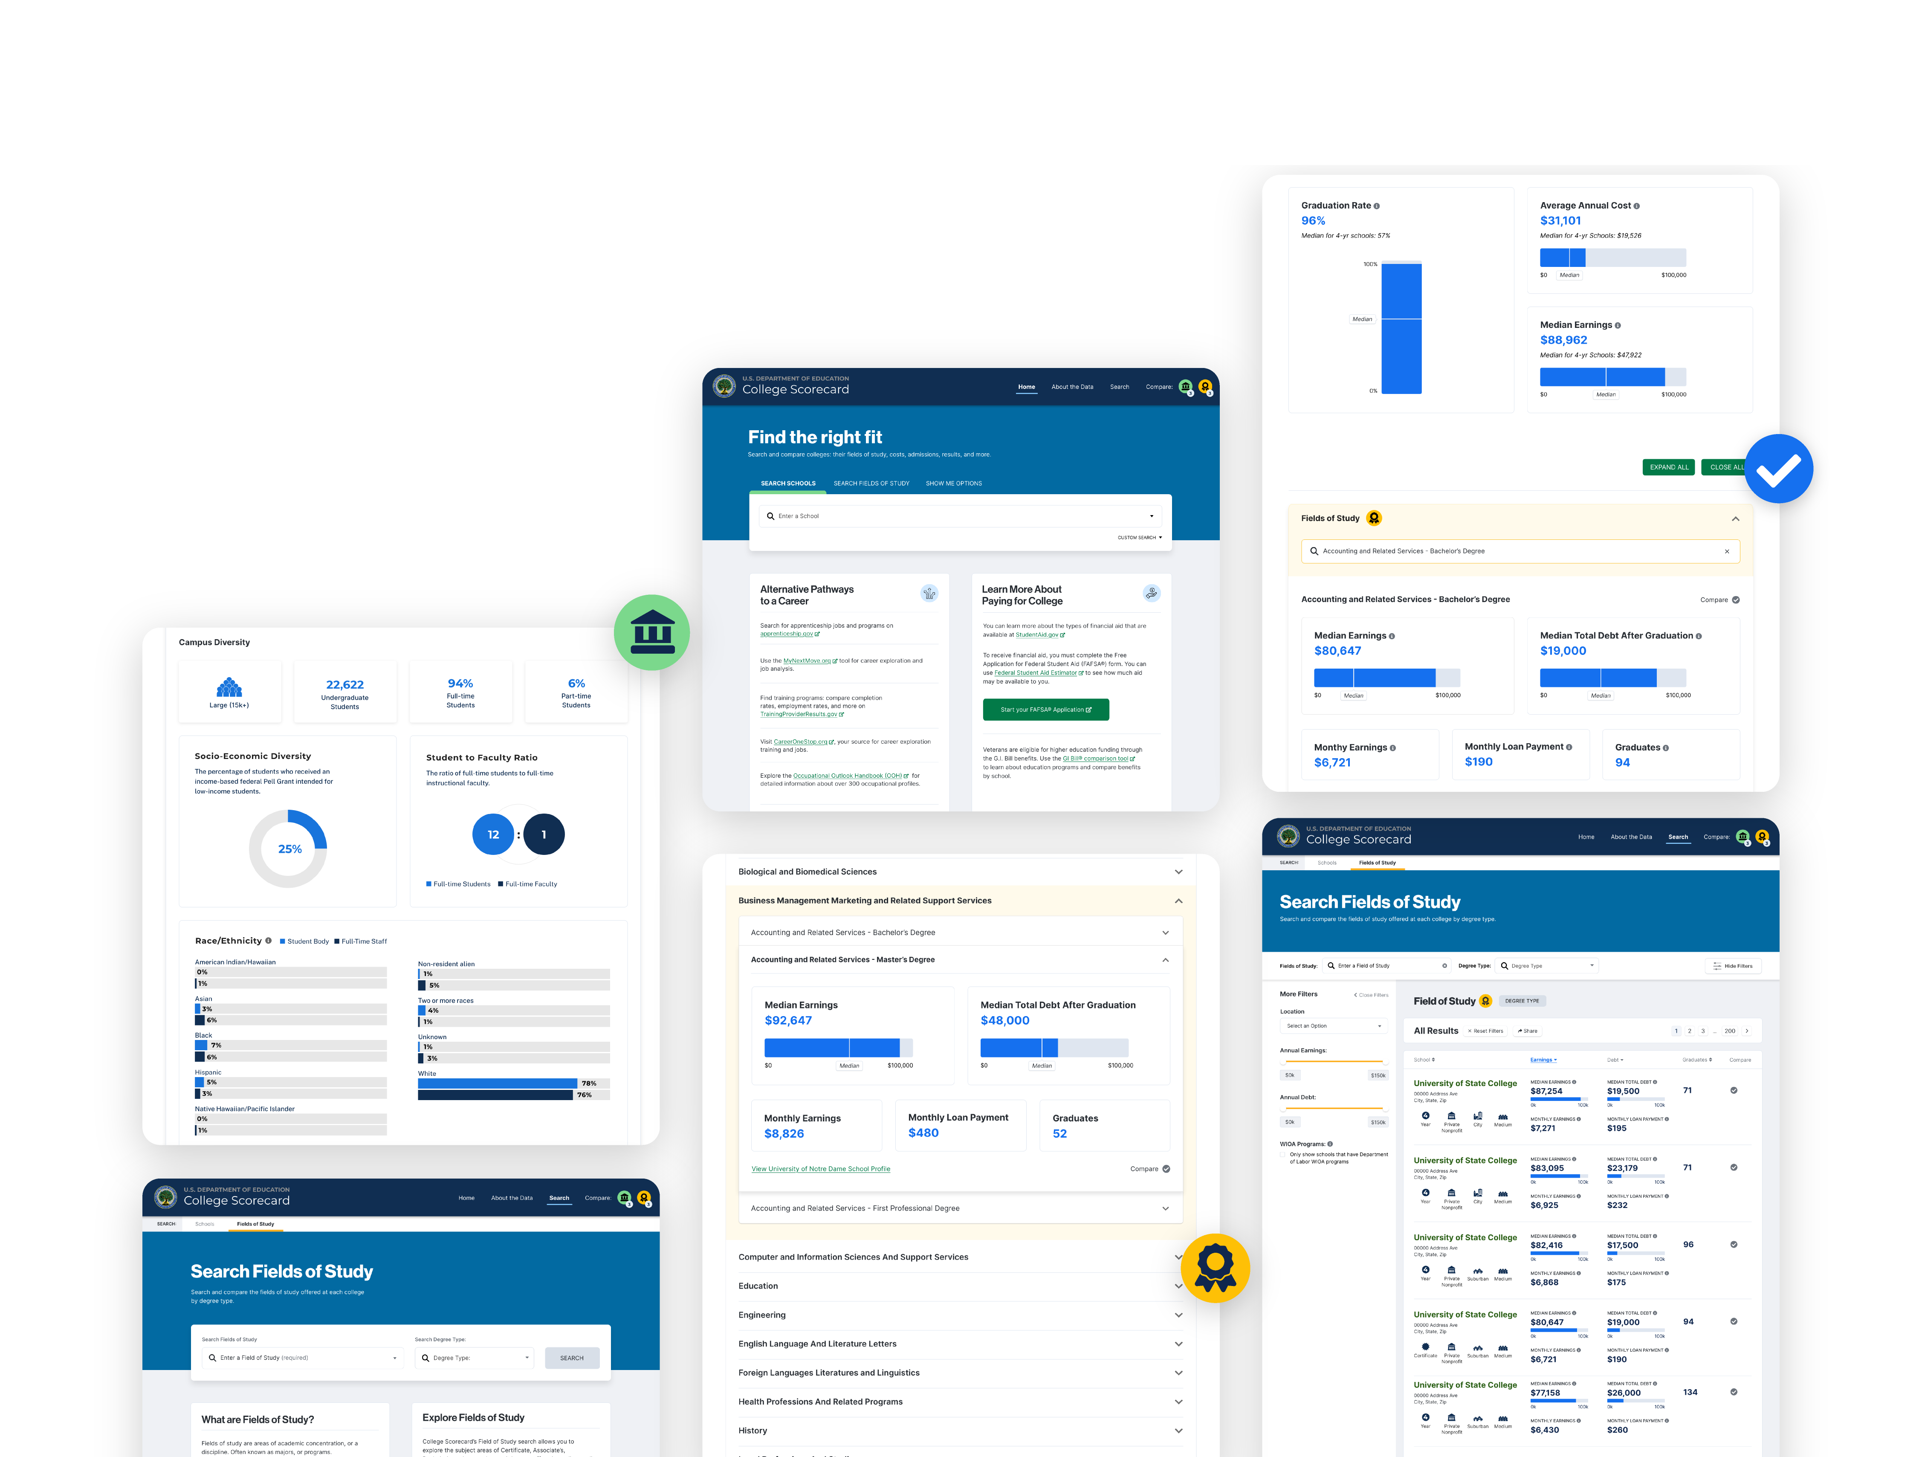
Key Features of College Scorecard
Detailed school profiles
Outcome data
Comparison tools
Customized search
options

Slide 13
How to Begin a Search
There are three distinct ways to begin your search using College Scorecard:
1 | 2 | 3
By school | Fields of study or major | Broad school characteristics, such as graduation rate, cost, acceptance rate

Slide 14

Independent Exploration
Practice using the search function.
What did you find interesting?
What was surprising?
What do you want to know more about?

Slide 15
Reflection

Slide 16
Reflection
Reflect on usefulness of College Scorecard data.
  What implications does this data have on college searches?
  What questions or misconceptions do you anticipate from students and/or families?
  What questions do you still have?
Questions about the College Scorecard? Contact scorecarddata@rti.org.

Slide 17

Questions & Answers

