Slide 1
Counselor and Advisor Training: Module 3
College Scorecard Website Training
Notes:
Welcome participants to the training and introduce yourself.

Slide 2
Session Norms
Participate and engage
Be fully present
Be generous with the knowledge you share with the group
Respect others’ opinions
Share airtime equitably
Notes:
Share session norms and ask for participants to indicate that they agree with these norms (i.e., thumbs up/thumbs down). Extend the opportunity to add to or edit the norms to fit the group.

Slide 3
College Access Advisors Modules
Module 1: Introduction to College Scorecard
Module 2: Navigating and Utilizing College Scorecard
Module 3: Practical Application of College Scorecard

Slide 4
Learning Objectives
Exploring How Students Make Postsecondary Enrollment Decisions
Understand how students make postsecondary enrollment decisions based on individual preferences and how the College Scorecard can help inform students to identify institutions and programs that may be a good fit for their unique needs.

Slide 5
Group Activator
What should college access advisors and school counselors be mindful of when helping others make the most out of their college search experience?

Slide 6
Understanding the College Scorecard Data

Slide 7
Key Data Metrics
Key Term | Description
Graduation Rate | The share of students who graduated within 8 years of entering the school for the first time, regardless of full-time or part-time status.
Average Annual Cost (in-state only) | A school’s cost of attendance minus any grants and scholarships students receive.
Median Earnings | The median annual earning of individuals that received federal student aid and began college at the institution 10 years ago, regardless of their completion status.

Slide 8
Interpret the Data
As a group, discuss the following:
How to interpret the data
How the definitions may impact that interpretation
Why these key data points matter in a school or college search
Refer to the guiding questions on the next slides.

Slide 9
Graduation Rate
The share of students who graduated within 8 years of entering the school for the first time, regardless of full-time or part-time status.
Who is included in this data point? Who is excluded?
What impact does the “of entering this school for the first time” have?
What factors influence an institution's graduation rate?
Why might a student not graduate within 8 years?
Why does "8” years matter in this data point?
Why would one want to know the percentage of students who graduated within 8 years of entering the school?
How does this influence a student’s decision about college?

Slide 10
Average Annual Cost
A school’s cost of attendance minus any grants and scholarships students receive.
Who and what costs is included in this data point? Who and what costs is excluded?
What does it mean to be an "average” cost?
How is the average cost different from the Sticker Price or the Net Price?
What factors might influence the average cost?
What factors might influence the difference between a student’s actual costs and the average costs?
Why does the school’s average cost of attendance matter to students and families? Why is it important for students to consider the sticker price and the net price?
Why is it important to be aware of the national graduation rates, which may not be as high as you expect?
How might this information influence your perception of a college's effectiveness in educating and graduating its students?

Slide 11
Median Earnings
The median annual earning of individuals that received federal student aid and began college at the institution 10 years ago, regardless of their completion status.
What does “median earnings” mean in layman’s terms? Who is included in this data point? Who is excluded?
What impact does the “regardless of their completion status” have?
If this data point includes students who “began college at this institution 10 years ago”, how old are most people likely to be now? How long since they graduated college?
How might different fields of study impact the median earnings and future debt?
How does “graduation rate” impact “median earnings” and future debt? What other factors might impact median earnings?
How does “median earnings” relate to “average annual cost”?

Slide 12
Related Topics
Why might one want to know how much graduates with federal student loan debt earn after leaving the school or college?
Why is it important to consider the demographic information of students when choosing a college? How might the diversity of the student body influence your educational experience and personal development?

Slide 13
Data Limitations of College Scorecard
The data represented on the College Scorecard is only for federal financial aid recipients.
The data focus on first-time, full-time students and does not account for the outcomes of transfer students, who may have different experiences and career trajectories.
The data do not capture all contextual factors of the college experience (e.g., student satisfaction, extracurricular opportunities).
The median earnings is dependent on the field of study selected.
What other limitations do you notice?
How might these limitations impact the data available to students?

Slide 14
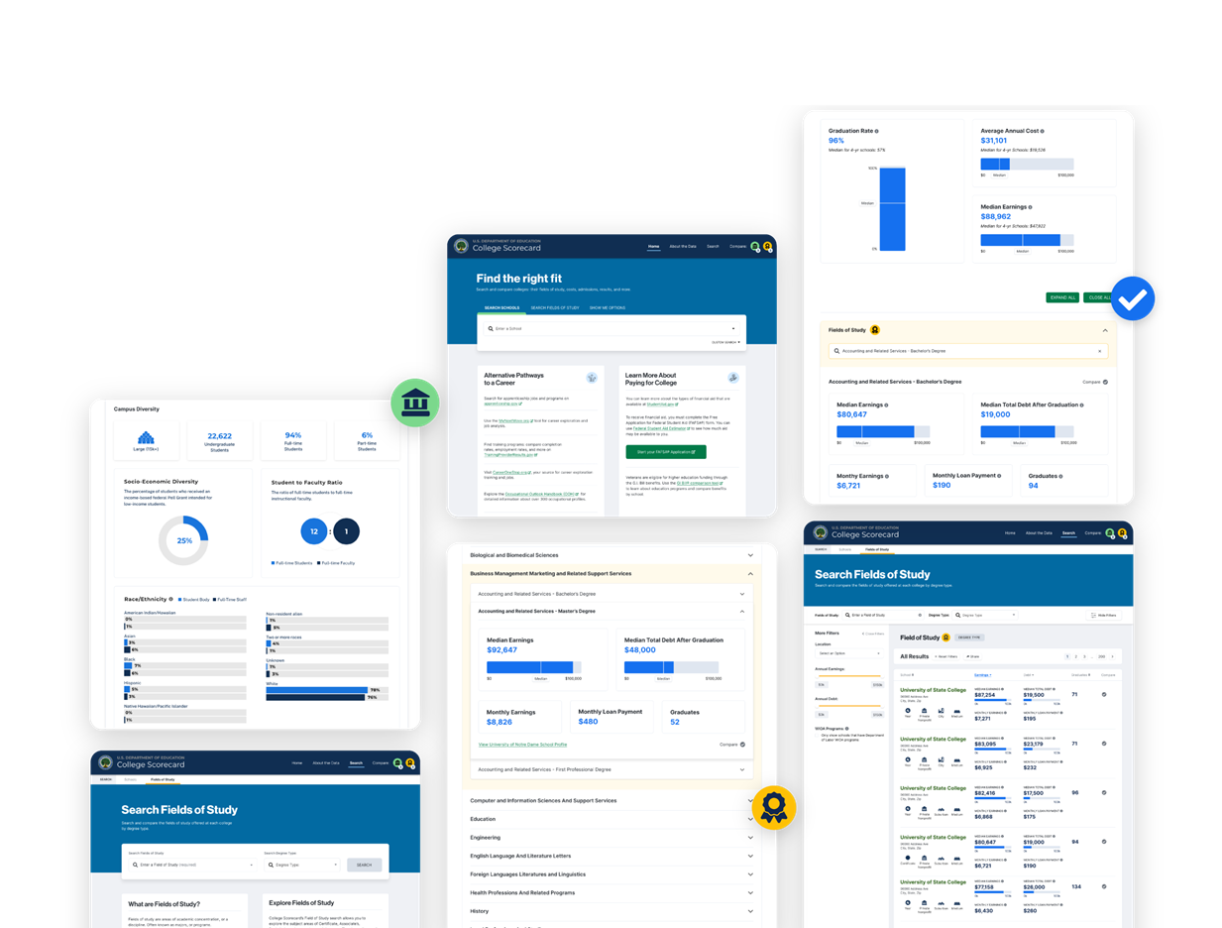
College Scorecard Comparison Feature Demonstration

Slide 15
Helping Others Make the Most of the Scorecard Data

Slide 16
Activity 1: Practice Scenarios
As a small group, discuss and respond to the scenarios provided. Record your responses on the handout.

Slide 17
Practice Scenarios Debrief
How was the tool valuable in addressing these scenarios around college choice?
In what ways would you integrate the College Scorecard into discussions with families to further enhance and inform their postsecondary education search process in these scenarios?
What other scenarios can you think of?
How might you align this to your own district/school priorities?
What questions do you still have?

Slide 18
Activity 2: Tips for Delivery
Review the Tips for Delivery document and discuss implications. Record your responses on the handout.

Slide 19
Tips for Delivery Debrief
How can you maximize the value of the tool with different audiences based on their backgrounds, interests, and needs?
What do you want to be mindful of when organizing and delivering the interactive activities in the College Scorecard training on your own?
How does College Scorecard strengthen the conversation with different audiences, including families to further enhance and inform their postsecondary education search process?

Slide 20
Reflection

Slide 21
Reflection
Now that you have explored the College Scorecard website and prepared for effective facilitation of the advisor training,
  What do you want to keep in mind?
  What do you still need to know?
  List 1 or 2 ways you plan to use College Scorecard to help students and families make informed decisions about college this school year.
Questions about the College Scorecard? Contact scorecarddata@rti.org.

Slide 22

Questions & Answers

