Slide 1
Introduction to
College Scorecard
Activity 1

Slide 2
Learning Objectives
Understand the purpose of the College Scorecard and how it can be used to help students and families make informed decisions about college.
Explore the College Scorecard's layout, main features, and functionalities to aid navigation.

Slide 3
Group Activator
What matters most to you about your future?
What are your long-term aspirations?
What kind of lifestyle do you envision for yourself as an adult?
What kind of work environment or setting do you see yourself thriving in?

Slide 4
About the College Scorecard

Slide 5
Career Landscape
By 2027, 70% of jobs will require education or training beyond high school.
College graduates are likely to earn more and experience lower unemployment than those with only a high school diploma.
SOURCE: https://www.ed.gov/raisethebar/postsecondary-pathways

Slide 6
What is College Scorecard?
The U.S. Department of Education’s College Scorecard is a free online tool to help students and families make data-informed decisions when choosing a college or university to attend.
SOURCE: https://blog.ed.gov/2023/04/updated-college-scorecard-will-help-students-find-high-value-postsecondary-programs/

Slide 7
Why Does Data Matter?
An informed decision is a decision based on facts or information.
What do you need to know to make an informed decision about attending college?

Slide 8
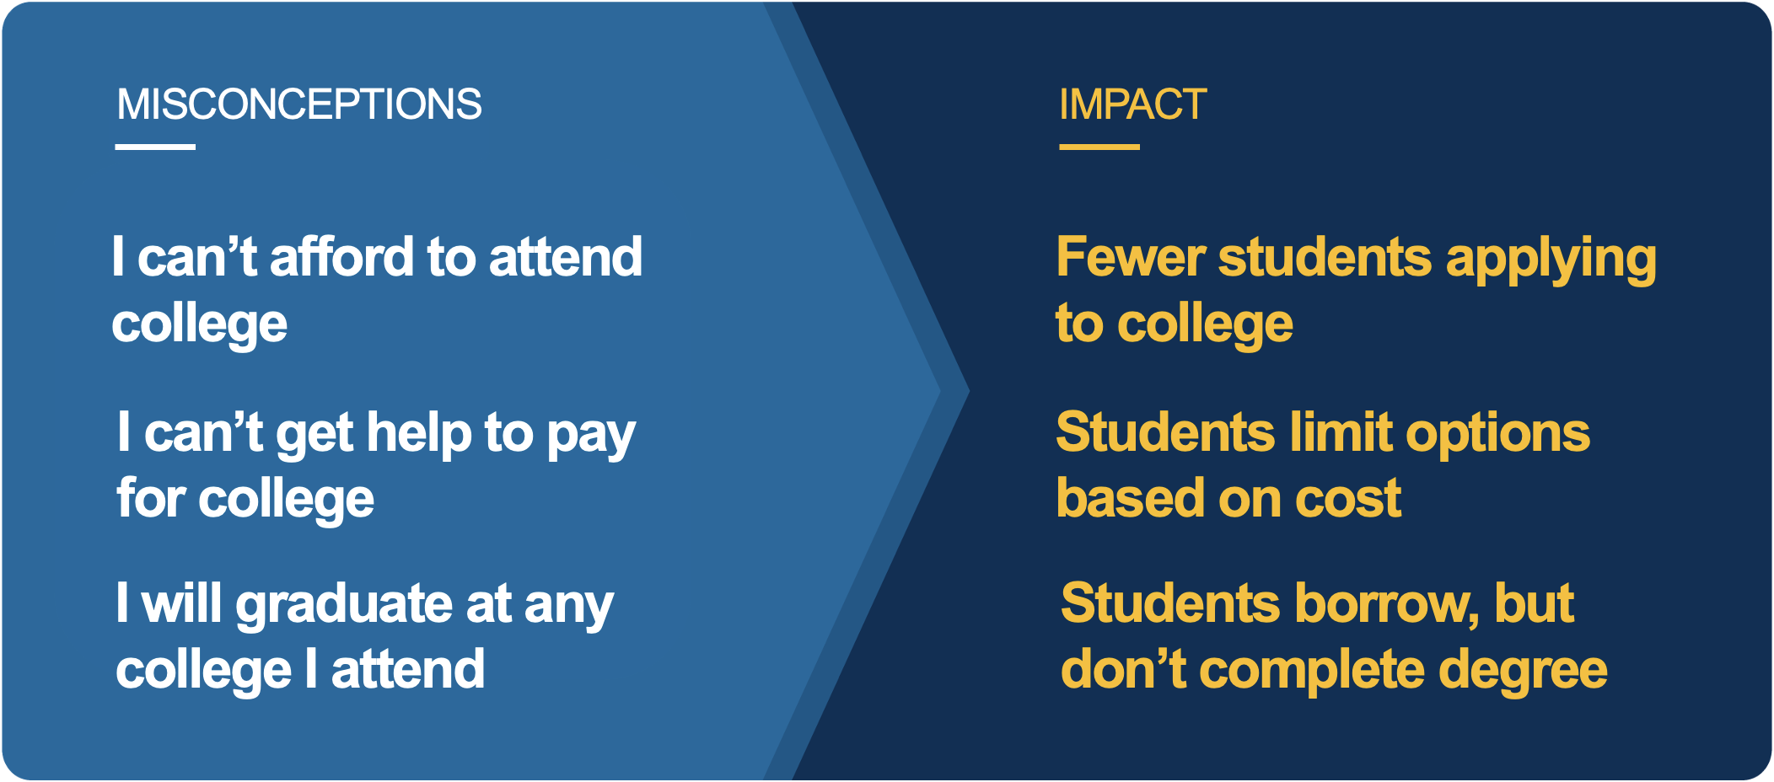
Why Does Data Matter?
Velez, E. D. and Horn, L. (2018 October). What High Schoolers and Their Parents Know About Public 4-Year Tuition and Fees in Their State. U.S. Department of Education: Stats in Brief. NCES 2019-404. https://nces.ed.gov/pubsearch/pubsinfo.asp?pubid=2019404

Slide 9
Why Does Data Matter?
By using data to inform your college search, you can ensure that the institutions you are considering are high quality and align to your individual interests, needs, and goals.
Velez, E. D. and Horn, L. (2018 October). What High Schoolers and Their Parents Know About Public 4-Year Tuition and Fees in Their State. U.S. Department of Education: Stats in Brief. NCES 2019-404. https://nces.ed.gov/pubsearch/pubsinfo.asp?pubid=2019404

Slide 10
Benefits of Using College Scorecard
Inform decision-making
Plan your finances
Compare schools easily
Tailor to your needs
Ensure trustworthy information
Why is it important to consider many data points when making an informed decision?
Why is it important to use a trusted data source?

Slide 11
Understanding the College Scorecard Tool

Slide 12
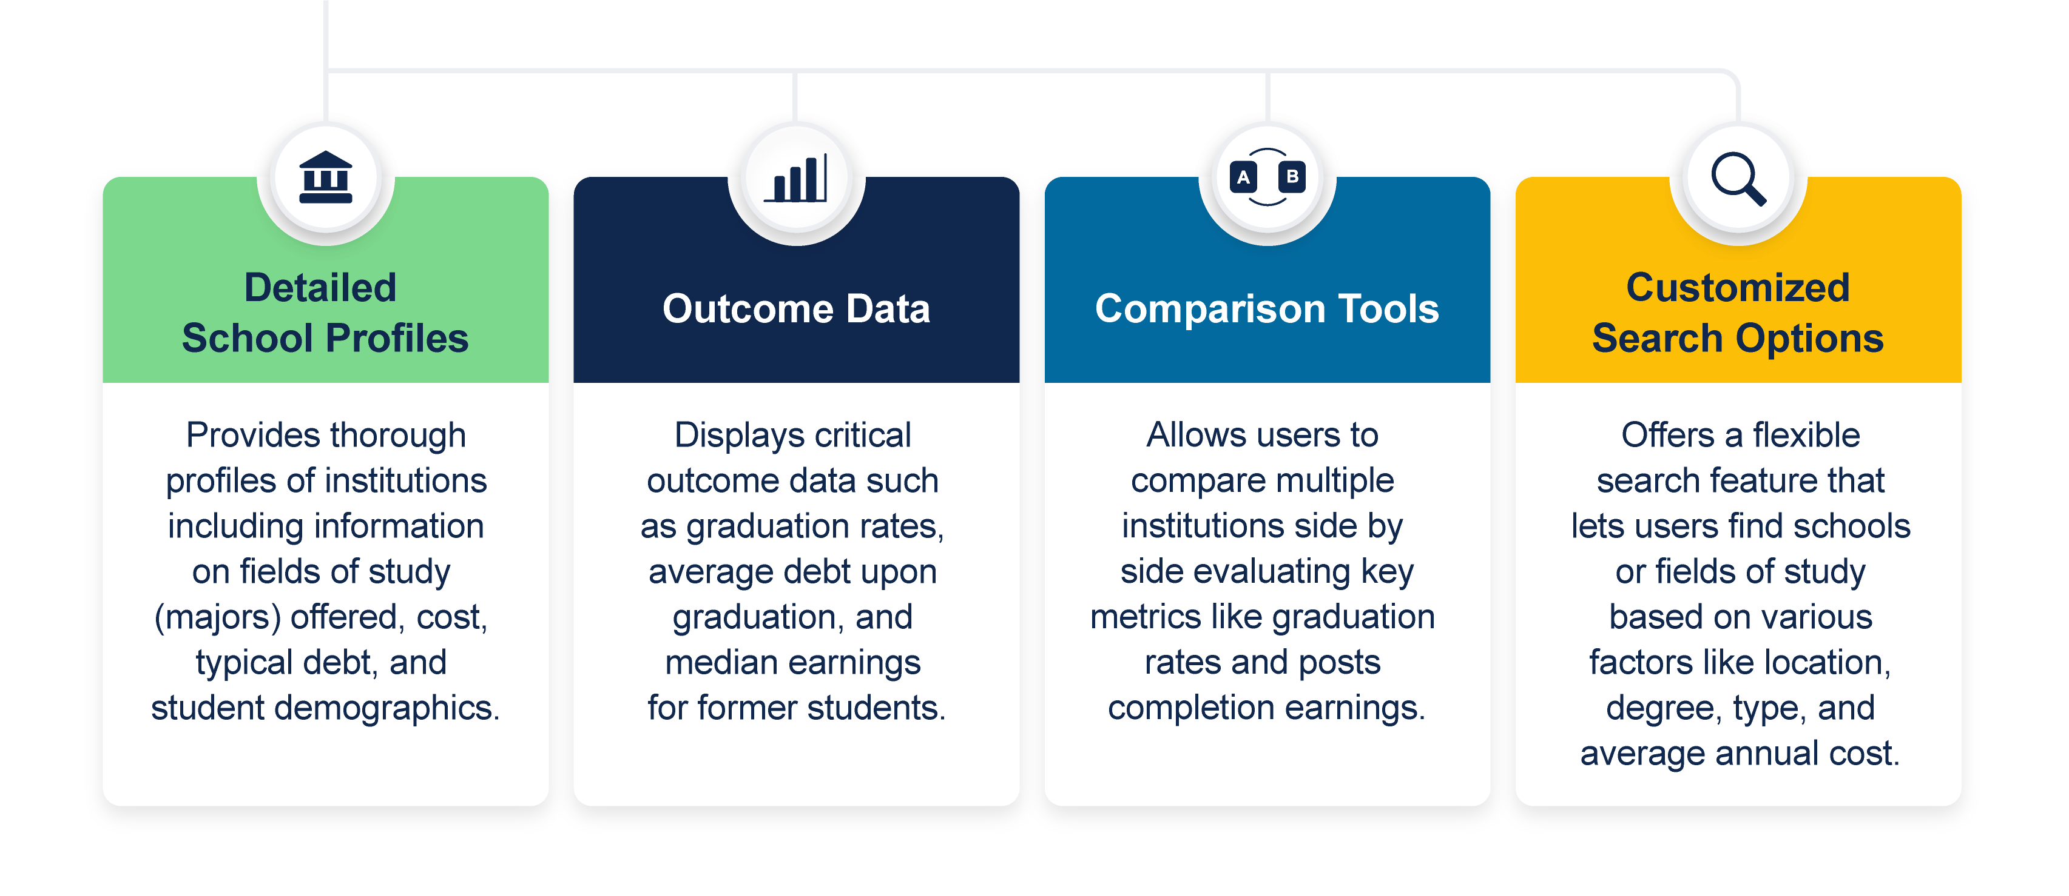
Key Features of College Scorecard

Slide 13
What isn't Included
You will not find the following on the College Scorecard:
  College rankings
  Information about sports teams or student clubs
  Student satisfaction
  Program rankings
Where else might you look to find this information?

Slide 14

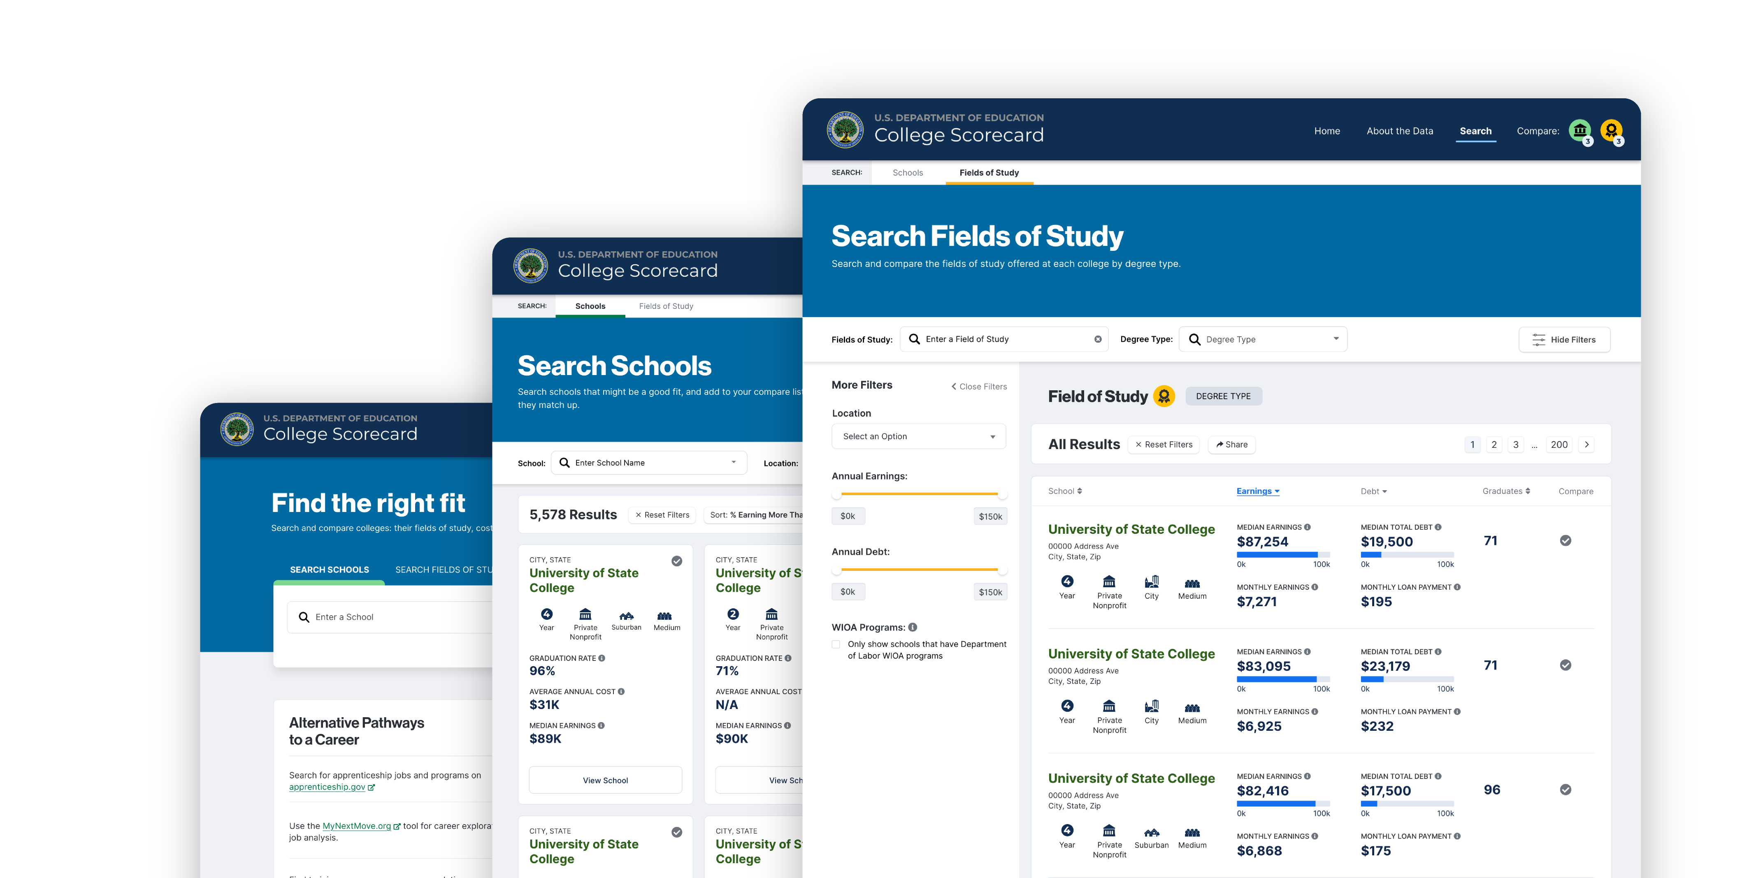


Ways to search
School
Fields of Study
School Characteristics

Slide 15
Key Terms
Key Term | Description
School/College | A 2- or 4-year degree-awarding educational institution.
Field of Study | A category of academic programs offered by institutions of education. Field of study is also known as a major.

Slide 16
Let’s Explore
CollegeScorecard.ed.gov

Slide 17
Key Data Metrics
Key Term | Description
Graduation Rate | Share of students who graduated within 8 years of entering the school for the first time.
Average Annual Cost (in-state only) | School’s cost of attendance minus any grants and scholarships students receive.
Median Earnings | The median annual earning of individuals that received federal student aid and began college at the institution 10 years ago, regardless of their completion status.

Slide 18
Graduation Rate
The share of students who graduated within 8 years of entering this school for the first time (regardless of full-time or part-time status).
  Why might a student not graduate within 8 years?
  Why is it important to be aware of the national graduation rates, which may not be as high as you expect?
  Who is included in this data point? Who is excluded?
  What impact does the “of entering this school for the first time” have?
  What factors influence an institution's graduation rate?
  Why would one want to know the percentage of students who graduated within 8 years of entering the school?
  How might this information influence your perception of a college's effectiveness in educating and graduating its students?

Slide 19
Average Annual Cost
The average net price for students who receive federal financial aid (e.g., Pell grants, federal loans) for one academic year of study. Net price is calculated by adding the advertised price for tuition, fees, books, supplies, and the average living costs at the school (on-campus, off-campus not with family, and off-campus with family) and subtracting the average grant and/or scholarship aid.
Who is included in this data point? Who is excluded?
What costs are included and excluded?
What does it mean to be an "average” cost?
What factors might influence the average cost?
What factors might influence if a student’s actual costs are different from the average costs?
Why does the school’s average cost of attendance matter to students and families? How is the average net cost different from a school’s “sticker price”?
How does this metric provide a more comprehensive understanding of the financial commitment involved?

Slide 20
Median Earnings
The median annual earnings of individuals who received federal student aid and began college at this institution 10 years ago, regardless of their completion status (i.e., graduating, transferring, withdrawing).
  What does “median earnings” mean in plain language?
  Who is included in this data point? Who is excluded?
  What impact does the “regardless of their completion status” have?
  Why would you want to know the earnings for someone who hasn’t completed the program?
  If this data point includes students who “began college at this institution 10 years ago”, how old are most people likely to be now? How long since they graduated college?
  Why would you want to know the median earnings after 10 years?
  How might different fields of study and completion statuses impact the median earnings and future debt?
  How does “graduation rate” impact “median earnings”? What other factors might impact median earnings?
  How does “median earnings” relate to “average annual cost”?
  Why might one want to know how much graduates with federal student loan debt earn after leaving the school or college?

Slide 21
Exploration Activity
Scenario:
You are interested in studying engineering. You would like to attend a college in-state that has an annual cost less than $15,000 a year. Use College Scorecard to find schools that align to these criteria. Once you have located a few options for schools, choose one and complete the chart in your handout.
As you complete the activity, consider how this information can help you make an informed decision about college.

Slide 22
Closing
What did you find useful with the College Scorecard?
How could you see yourself using these features of the College Scorecard in your college search?
What questions do you still have?

